Slide 1
Introduction to Psychology Lecture 1
Lecturer
Muhammad Behroz Khan
Abasyn University, Peshawar.

Slide 2
What is Psychology?
It is defined as ‘’scientific study of behavior and mental process.’’
Behavior includes anything we do, especially if it can be observed as talking, eating, running etc. It can be study in a variety of settings.
Mental process include thinking, perception, decision making, judgement etc.
These mental processes are not directly observable but can be studied through report by human research subjects.

Slide 3
Psychologist often study biological and physiological process that go together with both behavior and mental processes. For example brain waves during dreaming, heart rate during emotion etc.

Slide 4
Historical Background
For better understanding of subject matter of Psychology, we have to throw light on some of the historical background of Psychology.
The origin of psychology can be traced back to half million years when primitive societies assumed that behavior was caused by the presence of good or bad souls.
People have always been interested in the behavior of others throughout history. So the roots of psychology may be found in philosophy, religion, and science.
On the basis of these points the history of Psychology is divided into two periods.
1. Pre-scientific Period
2. Scientific Period

Slide 5
Pre-scientific Period
Some of our modern ideas of psychology came from Ancient Greece. The term Psychology was derived from the Greek words psyche (Soul) and logos (knowledge), which came to mean ‘’ the study of mind’’.
The pre-scientific period is divided into three periods:
Greek Period
Middles Ages
Islamic Period

Slide 6
i. Greek Period
Some of the early Greek Philosopher consider ‘’psyche’’ as a substance like breath, fire or air. Which was thought to control the body.
Hippocrates (430 B.C.)
Hippocrates was a Greek physician who thought that personality was made up of four temperaments and these temperaments were influenced the presence of ‘’humor or fluids’’ in the body.
Their problem of interest was the relationship between mind and body.

Slide 7
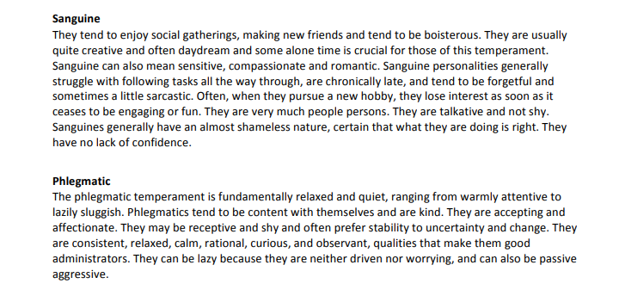

Slide 8
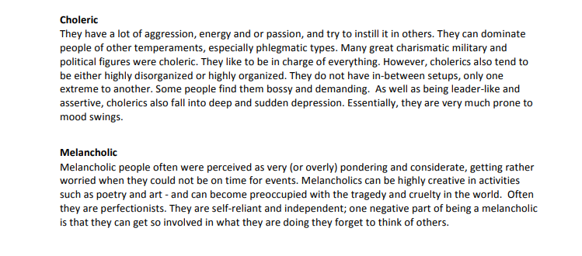

Slide 9
Plato (427-347 B.C.)
Stressed the controlling influence of ‘’Soul or Mind’’.
He postulated the theory of mind-body dualism and believe that as long as soul remains in the body, the man is alive, and when it leaves the body, the man dies.
Aristotle (384- 322 B.C.)
Rejected the Plato’s theory and suggested that mind is the function of the body as vision is the function of eye.
His concept of mind as function of the bodily process was an important step in the direction of making psychology as a science.

Slide 10
Middle Ages
Plotinus (205 - 270 B.C.)
He was inspired by the thoughts of Plato and Aristotle. He tried to understand religious beliefs through reasoning.
Saint (St.) Augustine (354- 430 B.C.)
He was a Christian philosopher, he believed that human being is the interaction of soul and body.
He was a founder of introspective method. He thought that an individual can understand his own inner feelings.

Slide 11
Islamic Period
The Muslim philosopher described the principles of life in the light of Quran and the Sunnah.
Al-Kundi (803-873)
Was great Arab philosopher, believed that our soul have originated from God’s soul.
He tried to combine religion and philosophy as both seek reality; philosophy focus on theoretical aspects whereas religion stresses upon action.
Al-Farabi (870-950)
Wrote more than 80 books on various topics.

Slide 12
He believed that a man is composed of body and soul, which belongs to God. God is immortal and above all human thoughts.
Farabi was influenced by the thoughts of Plato and Aristotle.
Ibn-Seena (980-1037)
He was physiologist, physician, poet, and psychologist.
According to him, there are three kinds of minds: human mind, animal mind, and vegetable mind. Only the human mind possess reason and intelligence.
Human Mind:
Have the ability to practically reason or active intelligence on which morality (what is right and wrong) depends.

Slide 13
Theoretical reason which is also part of human mind enable us to have abstract thinking.
Animal Mind
Animal mind have the ability to motive faculty and power of perception or cognition.
Vegetative Mind
Vegetative mind have the ability to be nutritive mind, having power of growth (body does not change its form and continue to increase till it attains full maturity), and the power of reproduction.
He believed that physical illness can be treated with medication but mental illness could be treated psychologically with religion.

Slide 14
He thought that body has no link with mind; body perishes but mind remain alive.
Shah Wali Ullah (1702-1763)
He wrote many books and made a deep study of human mind and behavior.
He discovered the causes of mental illness and treated them.
According to him conflict goes on between the positive and negative forces within human mind and healthy personality develops only by striking the balance between the two.
If irrational ideas are in excess, mental health is affected.

Slide 15
Scientific Period
During sixteen and seventeen centuries, philosophers and scientists proposed new theories in the light of their observation and experiments. The scientific period may be divided into two periods.
1. Renaissance Period
2. Modern Period

Slide 16
1. Renaissance Period
Early in sixteen century severe reaction was developed against unquestioning dependence on philosophy and faith in logic without observation. Other influences came from biology and physics.
Following are important figures of this period:
Francis Bacon (1564-1642)
He was founder of modern science.
He separate science from religion and philosophy.
He proposed several theories upon education, habits, and human personality.
He emphasized the importance of observation instead of speculation.

Slide 17
Renee Descartes (1596-1650)
He thought organism as a complicated mechanism, which activated to light, sound, and other stimuli.
He had a very inadequate concept of the structures and function of nervous system.
His study of human organism brought fresh light to psychology.
Charles Darwin (1809-1882)
He publish his book ‘’ the origin of species’’ in 1859 in which he outlined his theory of evolution.
In his theory, suggested that animals and people show behavior that is adaptive to the environment and helpful to their survival.

Slide 18
Paul Broca (1860)
A French physician identified a part of the brain called ‘’Broca area’’, which working as control centre for speech.
Weber (1795-1878)
About the middle of the 19th century the discoveries made in physics gave rise to a new field known as Psychophysics.
It is an area of psychology that compares the physical energy of a stimulus and sensation reported by a subject.

